Slide 1
Different branches of science
Success Criteria
Students will be able to:
list and describe the different branches of science we will be studying

Slide 2
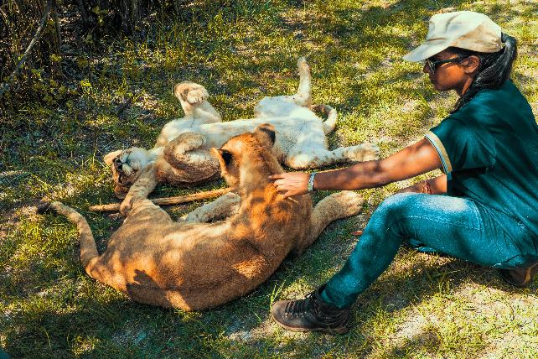
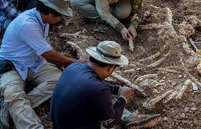
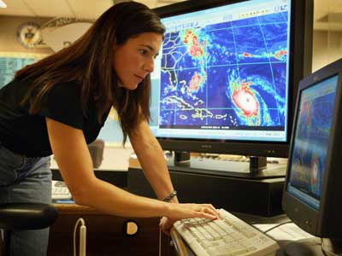
Different branches of science
There are many different types of science and there are many different types of scientists.
A zoologist studies animals.
A palaeontologist studies fossils.
A meteorologist studies the
weather
Question
What different types of scientists can you think of?

Slide 3
Different branches of science
In high school, we will be studying five different types of science:
Biology
Chemistry
Physics
Geology
Astronomy

Slide 4
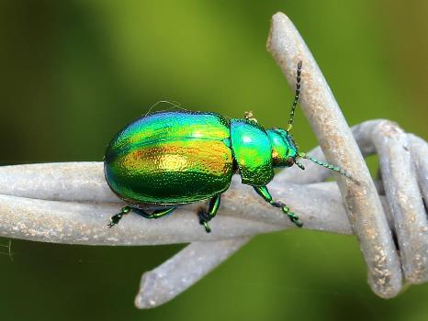


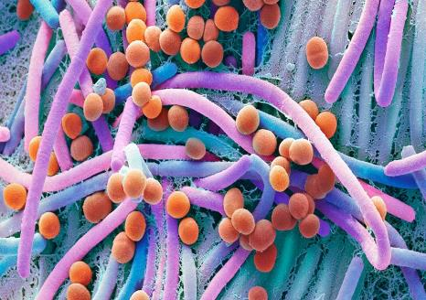
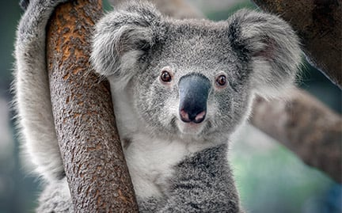
Biology definition
Biology is the study of living things.
Biologists study animals, plants, bacteria and viruses.

Slide 5
Biology definition
Question
What types of jobs involve biology?

Slide 6
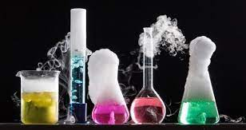

Chemistry definition
Chemistry is the study of chemicals.
Chemists study materials and reactions.

Slide 7
Biology definition
Question
What types of jobs involve chemistry?

Slide 8
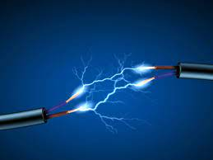
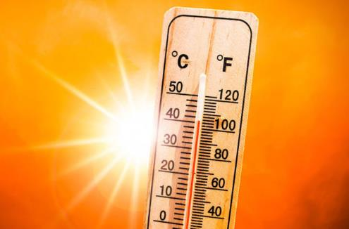



Physics definition
Physics is the study of matter and energy.
Physicists study light, heat, electricity, magnetism and motion.

Slide 9
Biology definition
Question
What types of jobs involve physics?

Slide 10
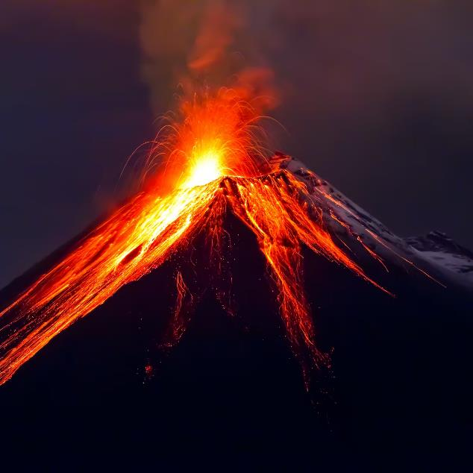

Geology definition
Geology is the study of rocks.
Geologists study the Earth, earthquakes and volcanoes.

Slide 11
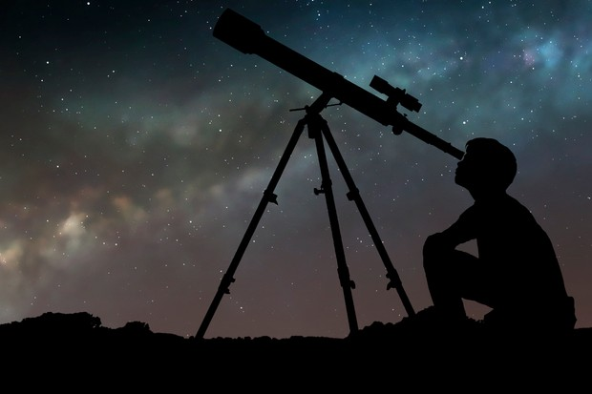
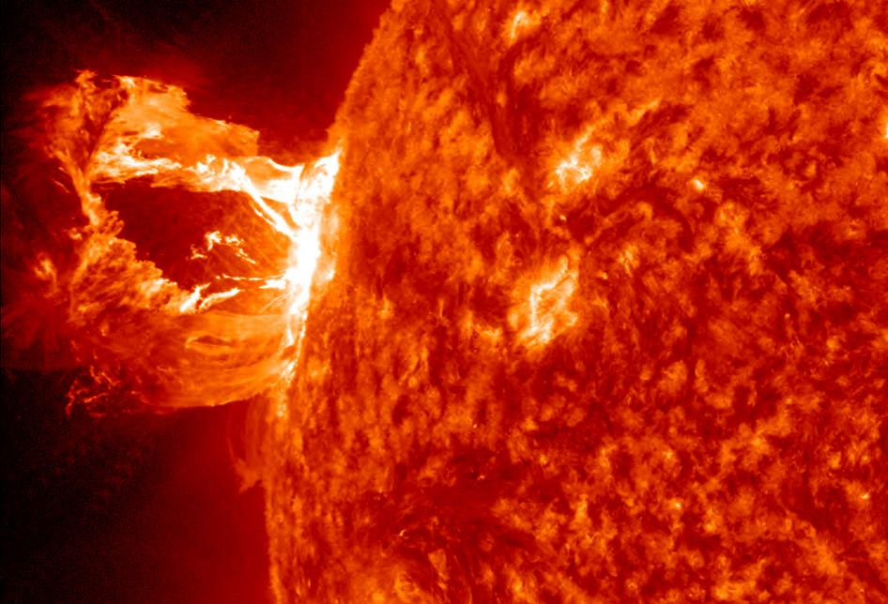
Astronomy definition
Astronomy is the study of space.
Astronomers study the planets, stars and the universe.

Slide 12
Biology definition
Question
What types of jobs involve geology or astronomy?

Slide 13
Different branches of science
Question
What are the five different types of science we will be studying?
Write them in your books.

